Slide 1


A SPY AMONG FRIENDS
Customer Base Viewing Habits.
By Shammah Anucha

Slide 2

How do we get customers to see ‘A Spy Among Friends’?
First, we should investigate the movie’s performance.
This will help us know if the viewers enjoy the content and are willing to promote it.
A Spy Among Friends
2

Slide 3
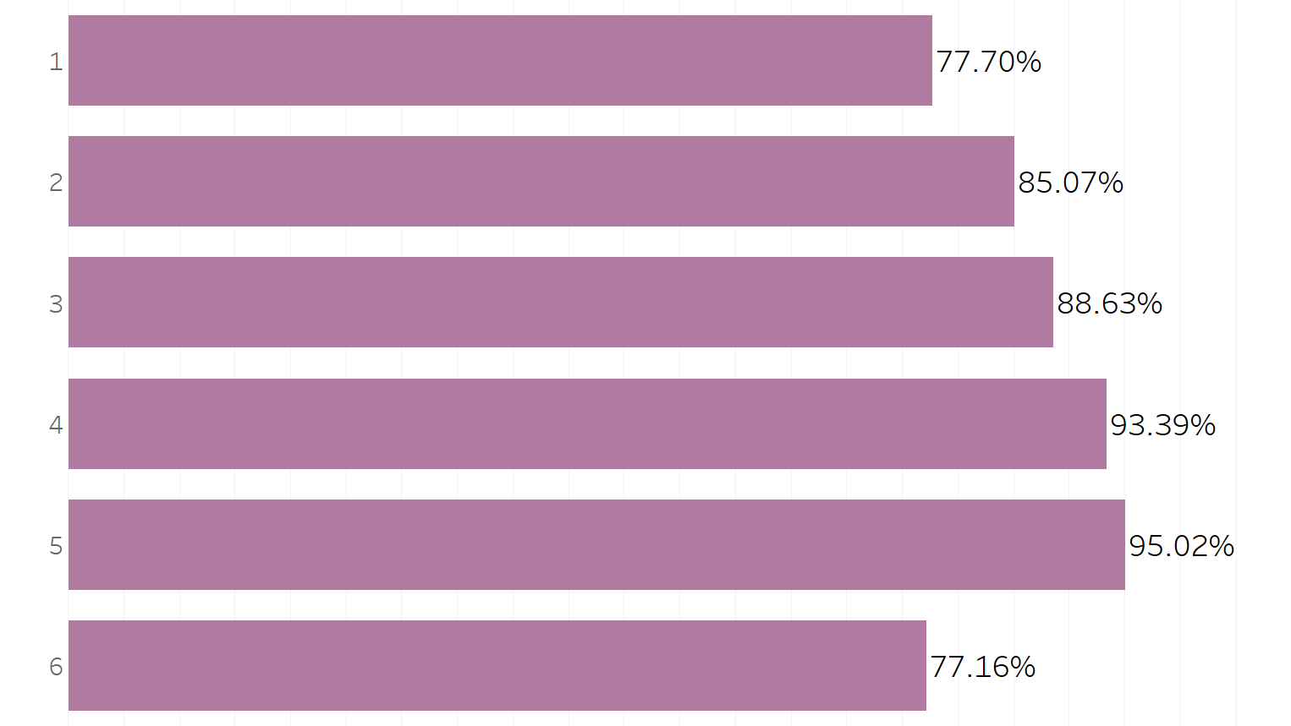

What is the watch rate of the 6 episodes?
In general, the engagement of the movie looks good. The start of the movie is rather boring but as the episode progresses, the viewers are hooked up. But it seems like the ball was dropped in episode 6.
Recommendation!
More data should be collected to know how the customers feel about the episodes. This will help the movie producers to produce more engaging content in the next episodes.
A Spy Among Friends
3

Slide 4
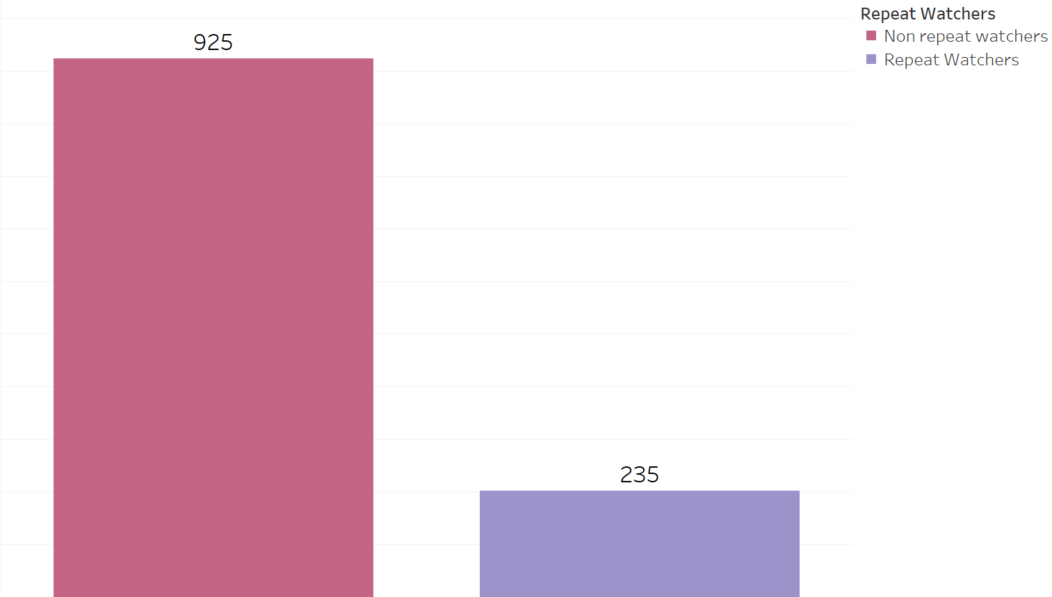

What you should know about Repeat Watchers
They stay on the platform longer
More likely to recommend
They must really enjoy the movie
We should increase the number
A Spy Among Friends
4

Slide 5
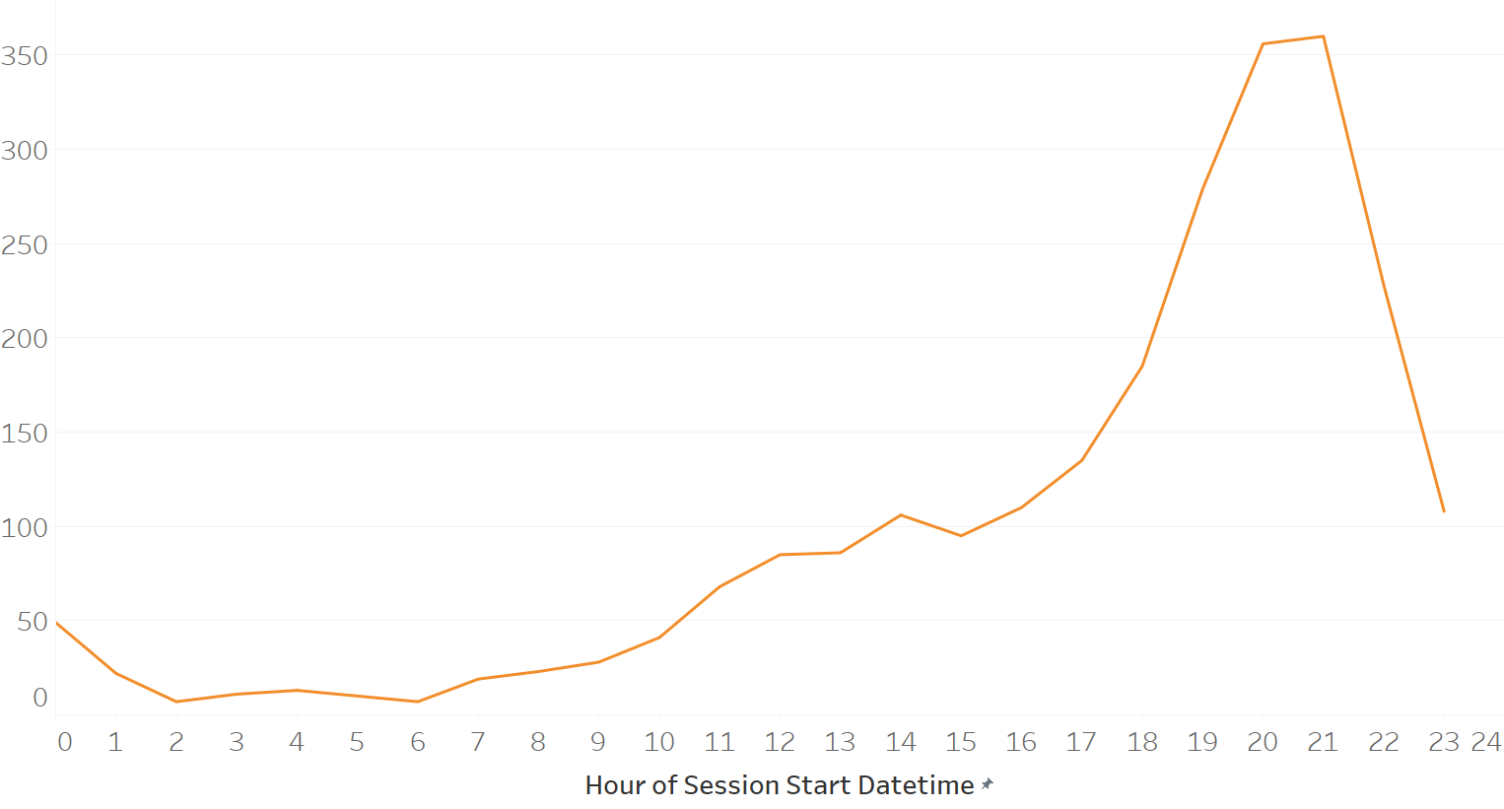
What time is the movie watched the most? Advertisements should start from 6 pm to 10 pm
A Spy Among Friends
5

Slide 6
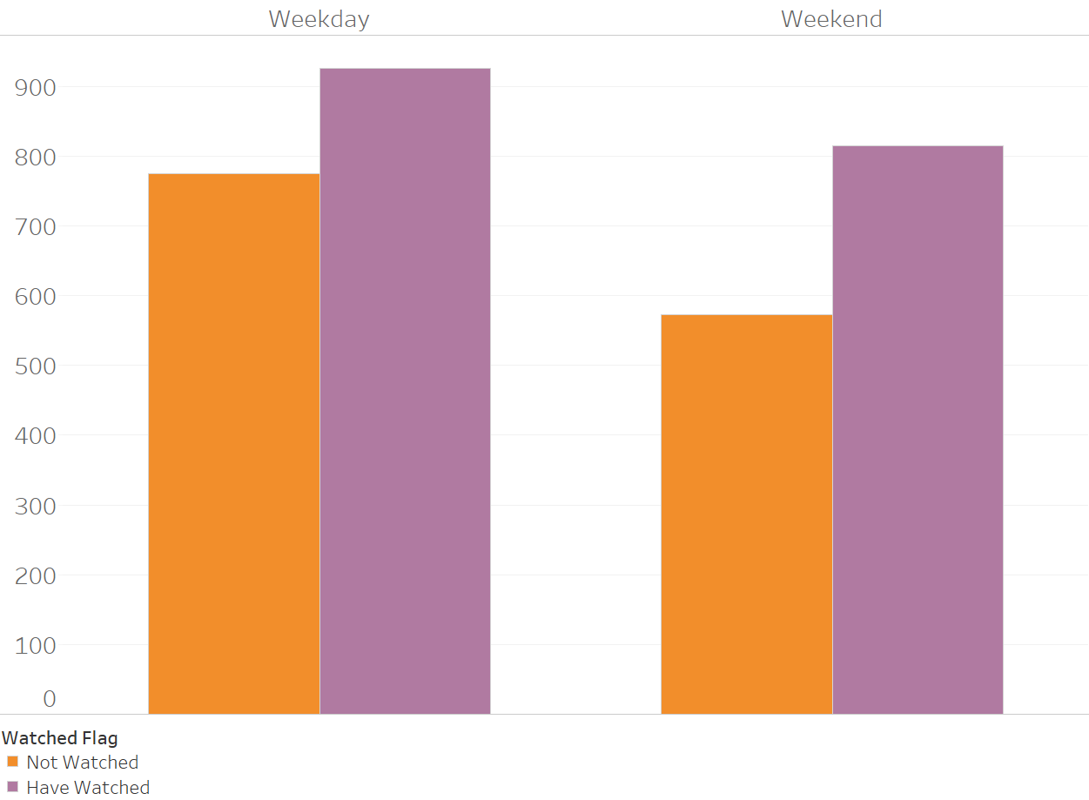
Most viewers watch movies on weekdays! People who have seen the movie viewed it on the weekday. We can advertise more during the week to increase that number!
A Spy Among Friends
6

Slide 7
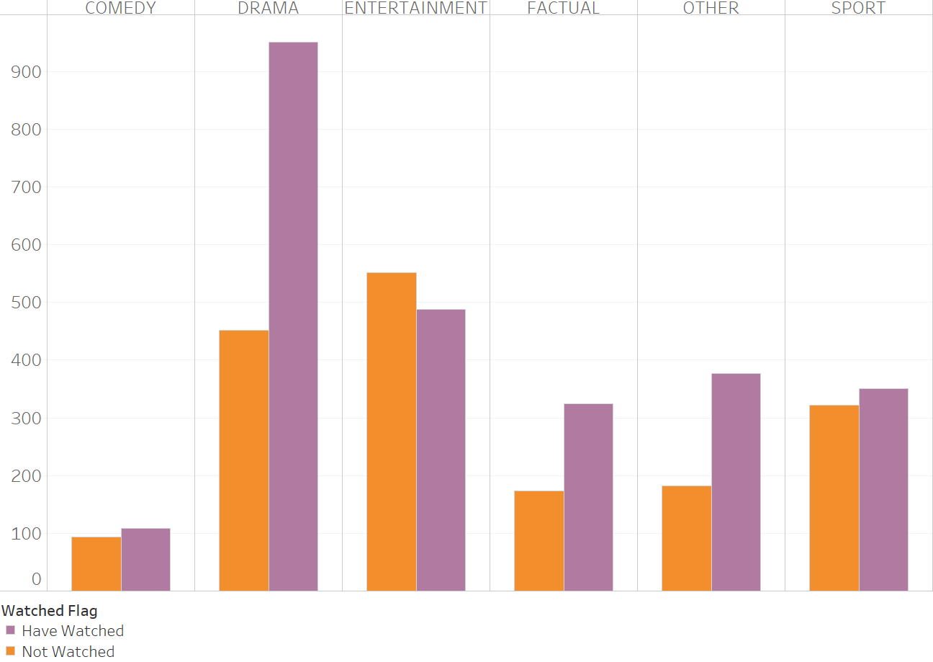
Drama is the most watched genre… Good news for “A Spy Among Friends” which is a Drama. Let’s make all Drama lovers see the movie. More ads, please!
A Spy Among Friends
7

Slide 8
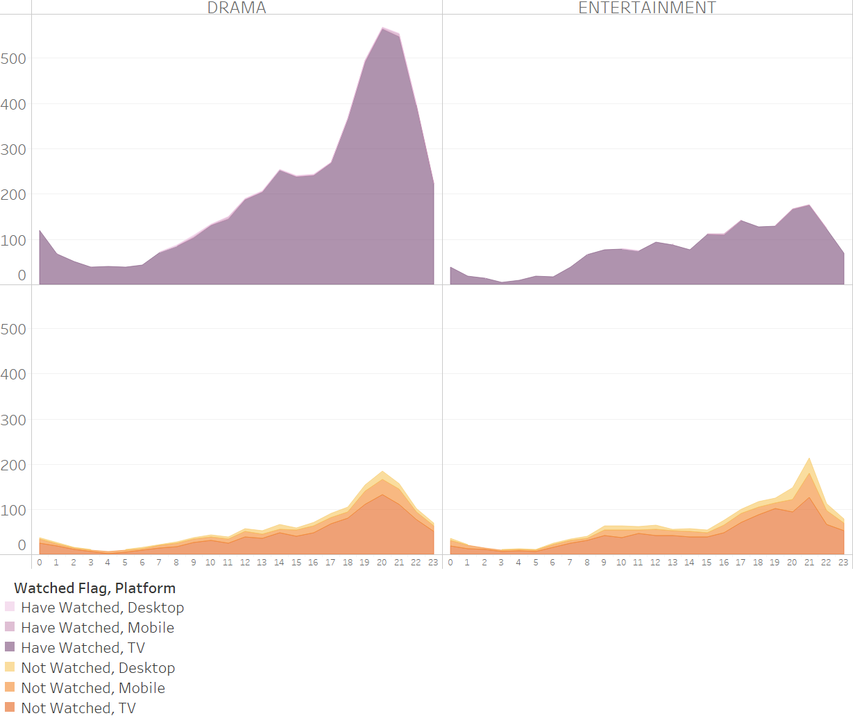
People who watched the movie during the week saw it on the TV… Let’s focus the ads on the TV platform.
A Spy Among Friends
8

Slide 9
Recommendations
Focus advertising to customers during the weekday from 6 pm to 10 pm on the TV platform.
Get more data about how the customers feel about the movie to create engaging content.

Slide 10
Thank You!

